Slide 1

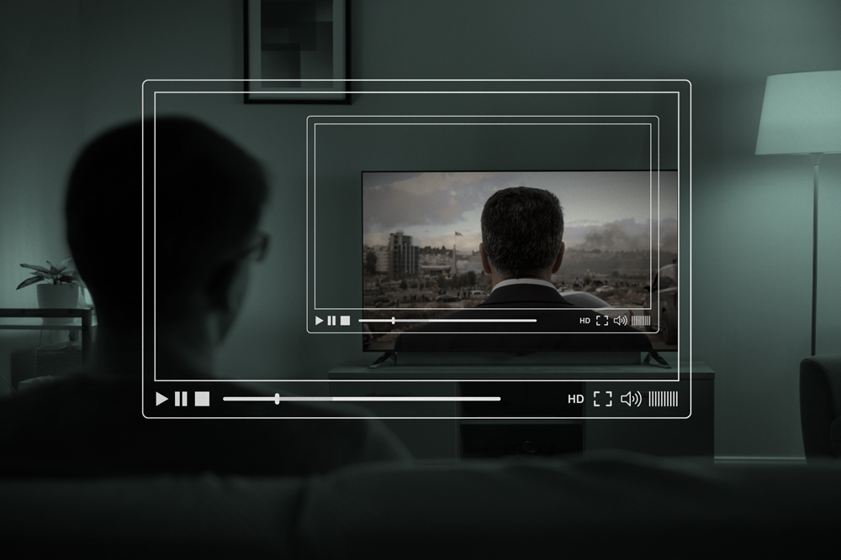
To study Participant's preferences & attitude towards online paid talent shows.
Presented by :
Saurabh Tiwari (17/ICS/083)
MBA(3rd semester)
Under mentorship of :
Mr. Subhojit Banerjee

Slide 2
Follow up :
Introduction
Organization overview
Literature Review
Objectives of the project
Research Methodologies
Data Analysis and Interpretation
Findings and Conclusion
Suggestions & Limitation
References
Annexure - Questionnaire

Slide 3

Organizational Overview
IFORTIS worldwide is a well-known Tamil Nadu based company that specializes in marketing,
Information technology, corporate training, and HR consultancies. IFORTIS believes that
ethical management is both a tool for adapting to rapid changes in the global business
environment and a vehicle for creating trust with many stakeholders, including as consumers,
employees, business partners, and local communities. To become a global firm of uniquely
skilled leaders who can help create a better world, the organization continually aims to provide
great services based on the values of transparency, timely communication, quality of service,
and competitive price.
IFORTIS Worldwide aims that businesses should help to create a more sustainable future for work,
employees on the global level, and their activities reflect that notion.

Slide 4
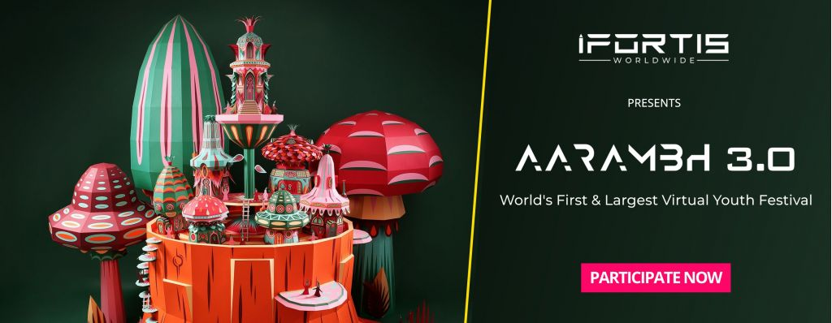

MY ROLE IN THE COMPANY ‘SALES & MARKETING TRAINEE’ LOCATION : REMOTE
I worked on the projects named AARAMBH 3.0 & Arise.
AARAMBH 3.0 was the 3RD version of world’s largest youth festival which held virtually (AARAMBH ), which took place on August 26th and 27th, 2021, for those who were 18+ in age.
ARISE was with the same concept except it was for the children aged between 5 to 18.
Numerous online competitions were held to show off their skills and win prizes are included in the event including singing, fancy dress, dance, storytelling, photography, painting, and many others. The events had a Rs 99 registration cost, people & kids who participated got Unique World Record, trophy and Record certificates .

Slide 5
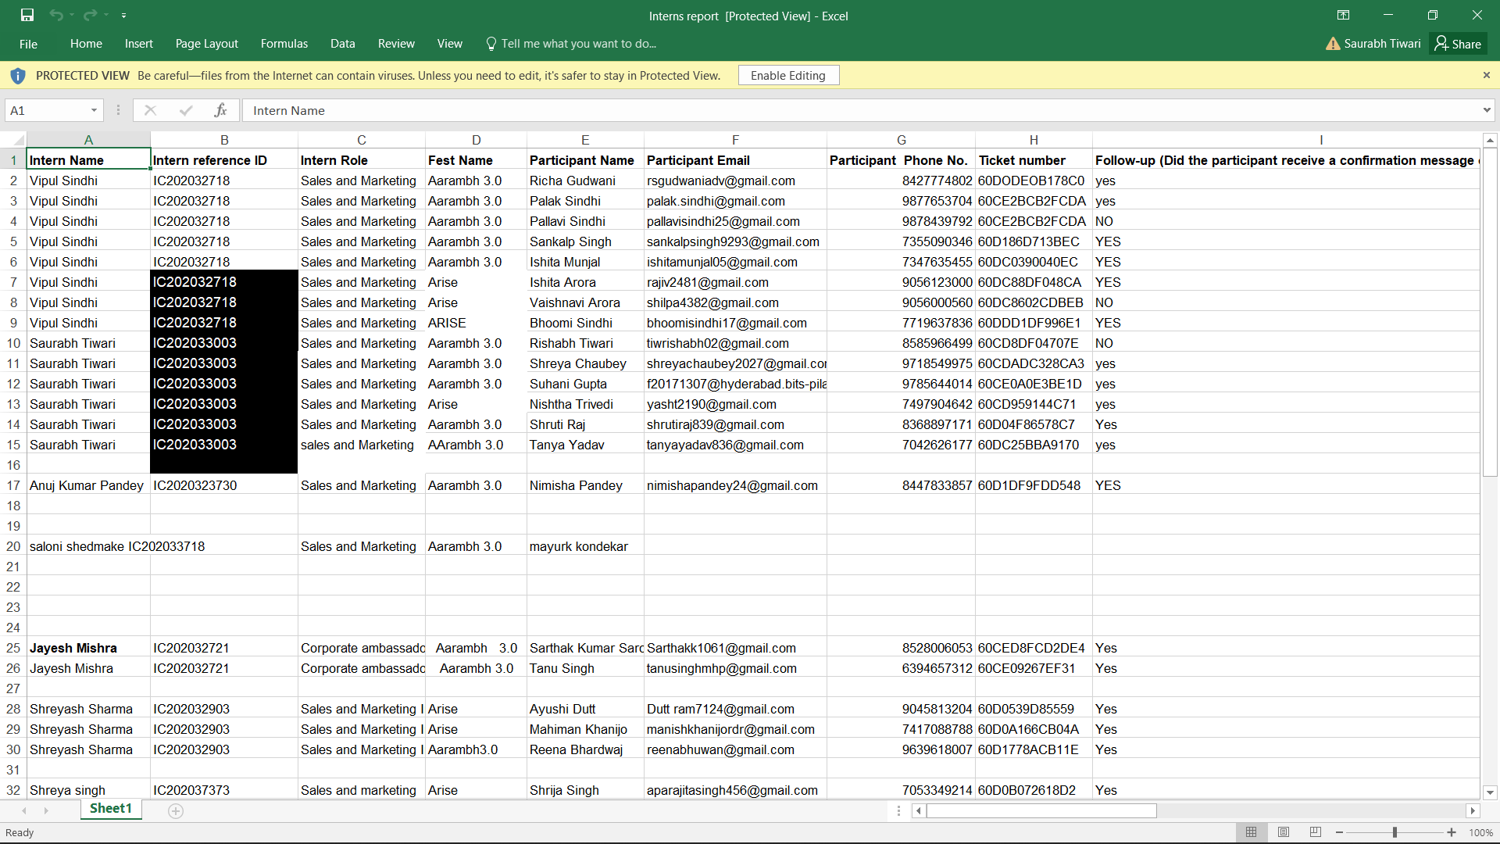
I was in charge of representing the company and finding as well as persuading potential consumers
to register for the events using the unique referral code issued to each intern. For this work, I researched
possible clients' demographics and reached out to them with the support of friends and family.
I generated tailored marketing messages and detailed descriptions of the event for customers,
encouraging them to participate in the contests. I was able to develop my marketing, teamwork,
and networking skills, as well as comprehend the foundations of marketing and brand representation,
by working on this project.
I was given the target to register 3+ candidates which I achieved in the given mean time.
Here is the list of all candidates I registered :

Slide 6
What I learnt :
I had the pleasure of working with Alaqsha Qadeer as my HR. She was always focused and
dedicated towards the task at hand. She constantly advised and motivated me regarding
the SOPs. She was always willing to help and provided relevant information along with precise
direction regarding my duties.
I was able to attain my goals with her aid and support for which I am grateful.
MY Learnings :
Sales Funnel
Creation of key visuals & presentations
Segmentation and targeting
Marketing & sales strategy
Consumer Behavior
Overall, I'm glad I took this internship since it was a wonderful experience that allowed me to meet
new people and gain significant knowledge and skills that will improve me in my future endeavors.

Slide 7
Introduction to ‘Virtual Programs’
You've probably participated in an online webinar, watched an on-demand workout class, or joined a conference through
video conferencing, or participated in various type of online talent shows which can be either paid or unpaid. You might have even sat at your desk and attended a conference. Virtual programs include all of the above. A virtual programs is one in which participants interact with the event and its material through the internet rather than participating in person.
According to Google Trends, the world is becoming increasingly virtual.
As technology advances, we are going toward a technological future in which everything we want is available online.
NOTE: In the wake of Covid-19, businesses across the world are forced to adopt a new reality that put digital marketing and operations center stage. Fortunately, with the right tools and strategies, promoting online events and managing virtual events can be a smooth & successful process.

Slide 8
Pros and Cons of Hosting Virtual Events
Pros are the following points:-
Flexibility
Scalable
Cost-effective
Engaging
Reliable
Cons are as given below:-
Lack of networking opportunities.
Can limit audience or participants.

Slide 9
Defining Online Talent Shows
The online talent show comes under the virtual programs, in which the participants don’t need to present physically to attend the show and showcase their talent. Almost all of us have obviously participated physically in shows in which we have performed the act, which can be of singing, dancing, poetry, speech, debate etc. It functions same as the physical one but the difference is that we don’t need to be present physically there.
Thanks to the technology advancement & internet which has made it possible. In such kind of talent shows people can participate by sitting in their home with all requirements in their hand and with ease of not going anywhere and showing their talents.

Slide 10
Purpose and Need of Such Online Talent Shows:
When people are willing or want to stay at home and at ease, a virtual talent show is an ideal method to pass the time. It's a terrific opportunity to recognize and enjoy the amazing community's performances, which can be seen from any group.
Another advantage of hosting a talent show digitally is that it allows for more diverse acts because participants are at home with all of the necessary supplies.
Following are the more reasons why online shows are needed:
Can be opened up to many more participants.
Travel Expenses and Worries Don’t Exist.
Introverts Thrive.
Those with Disabilities Have Easier and Greater Access
More Interaction with Attendees
Lower Sponsor Expense
Greater Exposure

Slide 11
Literature Review
Virtual conferences may become a supplement to — rather than a replacement for — real-life meetings.
Credit: René Bohn sack
In the mid-1990s, with the explosion of the Internet, virtual communities appeared and started to evolve rapidly
over the past two decades (Elliot et al.,2013).
As more and more people use the Internet on a daily basis and new attractive technologies make an increasing number
of virtual communication channels available such as mobile devices (Gottlieb & Bianchi, 2017),
Traditionally, despite the noticeable evolution of information technology, attention to virtual events was likely to be
disregarded because of face-to-face events’ substantial benefits (Adema & Roehl, 2010). Arvey (2009) articulated
the importance of face-to-face meeting events by describing the several benefits.
The virtual events platform ‘6Connex’ argued that the number of virtual events has increased by up to 1,000%, and
52,000 events and subevents have been held on their platform since the start of COVID-19 (Forbes, August, 2020).

Slide 12

Project objectives :
To assess awareness & attitude of performers towards online paid talent shows.
To identify preferences/barriers related to online paid talent shows.
To analyze how these talent shows are affected by demographic variables.
To analyze how these talent shows are affected by profession of the performers.

Slide 13
Research Methodologies
Research methodology is a way to systematically represent a research on any problem. It tends taken by the researcher in studying the research problem along with the logic behind them. It tends to define the methodology for the solution of the problem that has been undertaken for the purpose of the study.
Methodology explains the methods used in collecting information to the steps touch are as follows
RESEARCH PROBLEM
The research problem is to study the “Participant's preferences & attitude towards the online paid talent shows ”
DESCRIPTION OF RESEARCH
Marketing Research design specify the procedure for conducting a research project. The survey has been conducted with the objective to know the preferences & attitude of the participant's towards online paid talent shows .

Slide 14
Types of research methods used:
DESCRIPTIVE RESEARCH.
Descriptive Research is used to collect information from participants to study the Preferences, Awareness
and Attitude with the online paid talent shows.
EXPLORATORY RESEARCH.
Exploratory Research is concerned with discovering the general nature of the problem and the variables
that are related to research study.
TYPES AND SOURCES OF DATA
For the purpose of research study, the data is usually collected from two sources :
1) Primary Data
2) Secondary Data

Slide 15
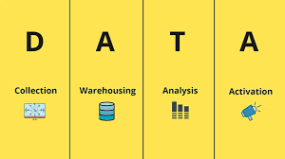
PRIMARY DATA
Primary Data is the data collected for the first time for the purpose to solve the problem at hand. In this study the primary data is collected by survey research i.e. collection of information directly from the respondents by personal interview, a questionnaire method is used to collect the information from the respondent.
SECONDARY DATA
The major sources of secondary data are as follows,
Websites
Broachers
For this research report the data used is only Primary Data, which has been collected through a survey using google form.

Slide 16
Sample selected for the study
A total of 63 respondents is selected for the study.
Questionnaire method using google forms has been followed for collecting the response from the
respondents .
Area of the study: The study area will be limited to Delhi NCR only.
Tools for analysis: After the collection of data through the questionnaire, editing will be done
carefully. Based on the responses of the samples, tables will be prepared. Data analysis has been
performed using a tool known as Tableau Public.

Slide 17
Data Analysis & Interpretation using Tableau
Tableau aids with the visualization and comprehension of data. Our visual analytics technology is revolutionizing the way people solve problems with data. Discover why businesses of all sizes rely on Tableau to help them become more data-driven.
Tableau Public is a free online platform for sharing and exploring data visualizations. Tableau Desktop Professional Edition or the free Public Edition can be used to generate visuals by anyone. With millions of fascinating data visualizations, or " vizzes," as we like to call them, anybody can see and understand vizzes about any public data topic under the sun, bringing data into everyday life and enabling a community to grow and learn from one another.'
'Easily create stunning interactive graphs, maps, and live dashboards in minutes on our free platform. No coding required. Connect to data in a variety of formats like Excel, CSV, and Google Sheets. Save to your Tableau Public profile to pick up where you left off.

Slide 18
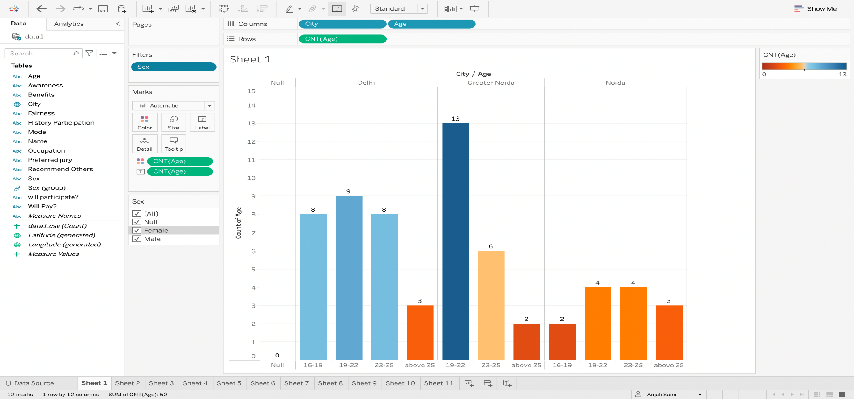
SURVEY ANALYSIS
Graph 1: Respondents from different age-group and city.
Interpretation: From the above graph it can be determined that from the total respondents of the survey the most responses were from Delhi with a total of 28, Gr Noida comes at 2nd with total of 21 and Noida at 3rd with 13 responses. If talk about age-group, 19-22 age group heavily participated as compared to other groups in Delhi and Gr. Noida, but in Noida 19-22 & 23-25 age-groups equally participated.
The respondents of Delhi from different age -groups approximately equally participated but in case of Gr Noida there is lot of difference in number of respondents among different age-groups.

Slide 19
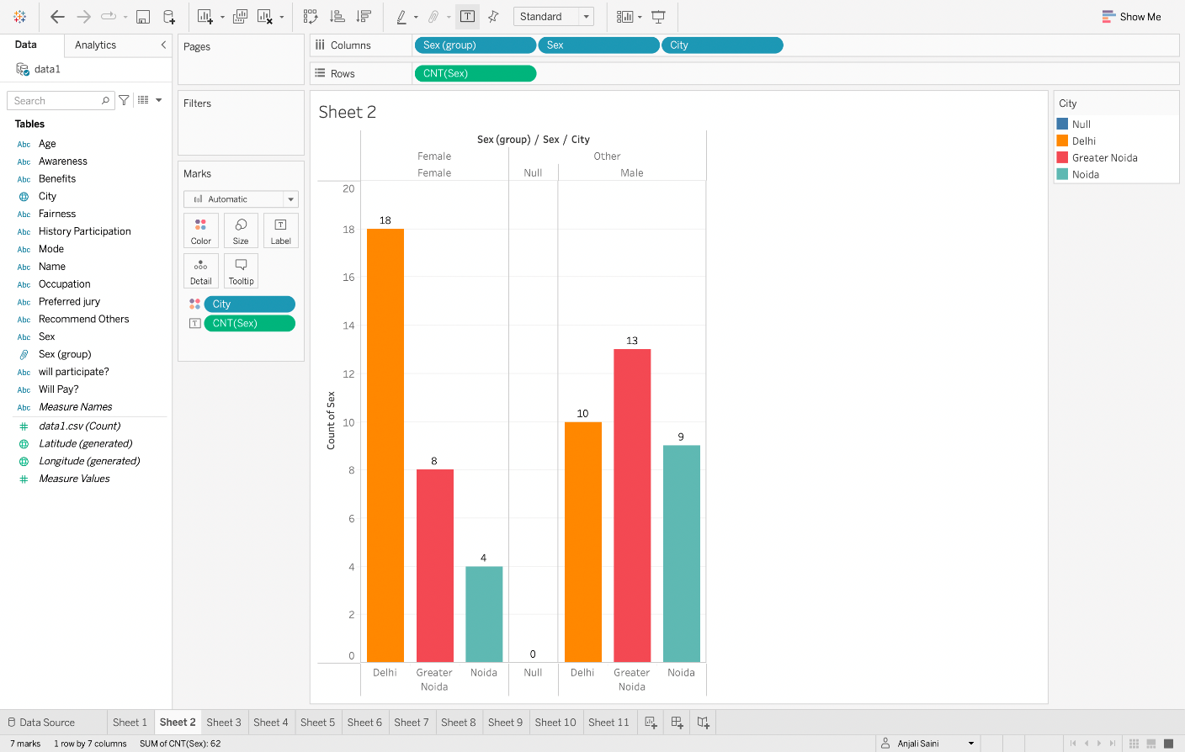
Graph 2. Analysis of respondents from different area based on sex.
Interpretation: This graph shows that most female respondents were from Delhi with the tally of 18 and in case of males the most respondents from Gr Noida with the number of 13.
Further females who participated in the survey from Gr Noida were 8, and from Noida only 4.
Males tally as participants of the survey stands 10 from Delhi and 9 from Noida.

Slide 20
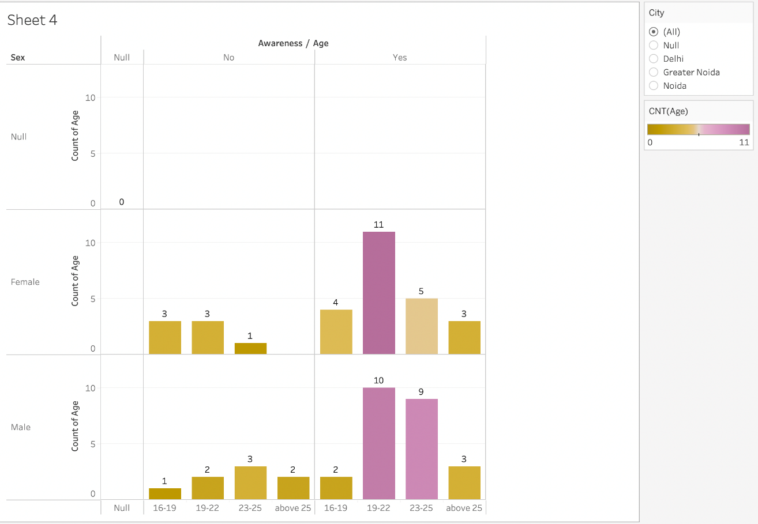
Graph 3: Awareness according to Gender and their age group.
Interpretation: From the above graph, it is clear that out of all respondents, 7 respondents belong to Female gender who weren’t aware of the online talent shows & 8 male were also unaware of such thing. On the other hand, there are 23 female and 24 male respondents were aware of such online shows. This shows that there are people are much more who are aware about it than the other who have not heard of such thing before. If I say about the age and awareness relation then the females of age group 19-22 is more aware than other age group and the same case applies with the males too.

Slide 21
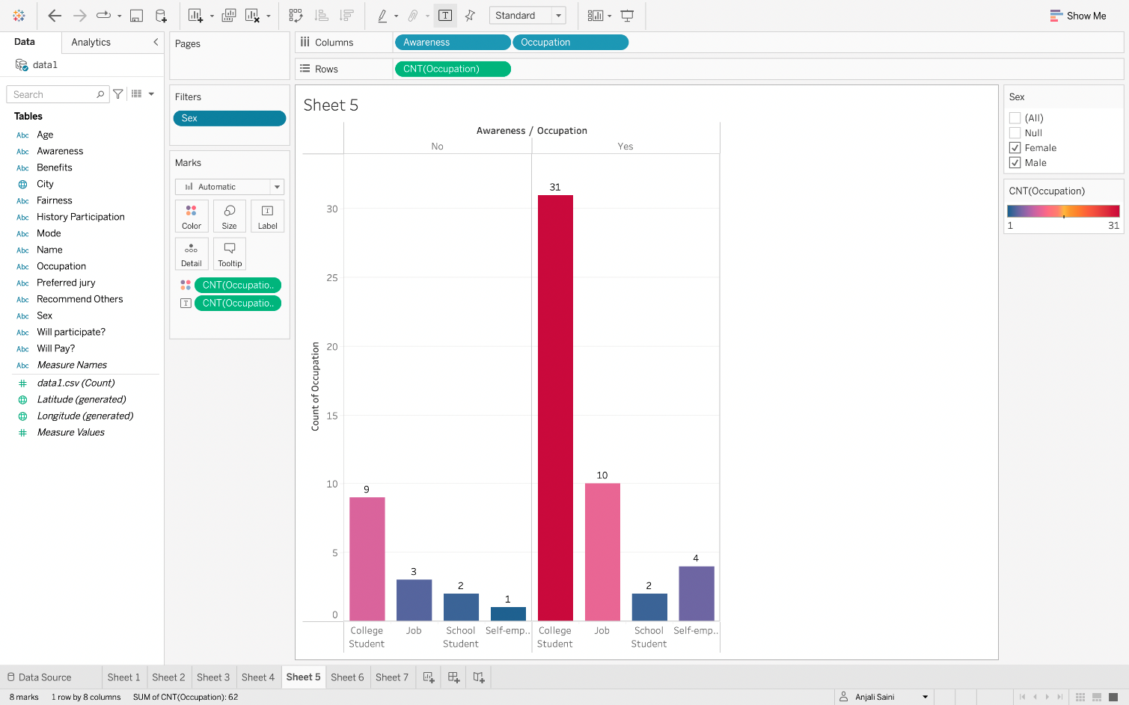
Graph 4: Awareness based on the occupation of the respondents.
The above-mentioned graph shows the awareness towards such online talent shows based on the occupation of the respondents. Here, we can clearly see that the number of college students are highest in both the cases which are 1. Are aware about these kind shows and 2. Aren't aware of the show which is 31 and 9 respectively. The number of total respondents who are not aware are 15 and who are aware are 47.
But if we compare the respondents who have job then the results shows that respondents who have job and aware about these kinds of shows are 10 and who are not aware are only 3. Self employed are also aware with the number of 4.

Slide 22
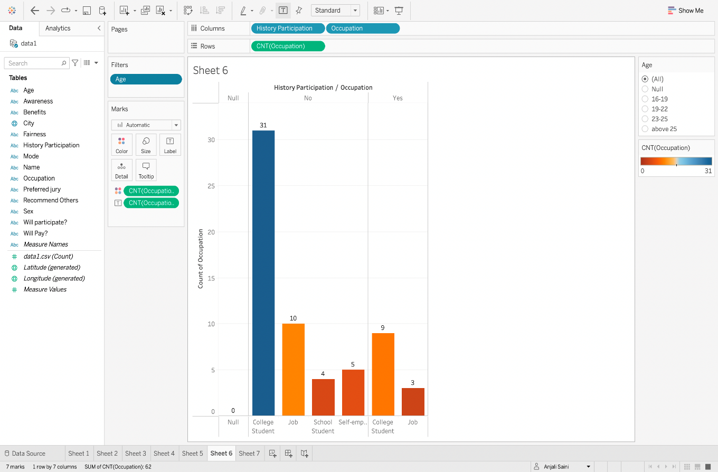
Graph 5. History of participation based on the occupation of the individual.
From the graph it has been observed that, 31 college students ,20 people having job, 4 school students and 5
self-employed respondents have never participated in such shows. Which shows that school students and the
self-employed people have never participated in any such kind of events. Only 9 college students and 3 respondents
having job have history of participation in such kind of online talent shows.
This shows that who the school students and self-employed people are most vulnerable to such kind of online events.

Slide 23
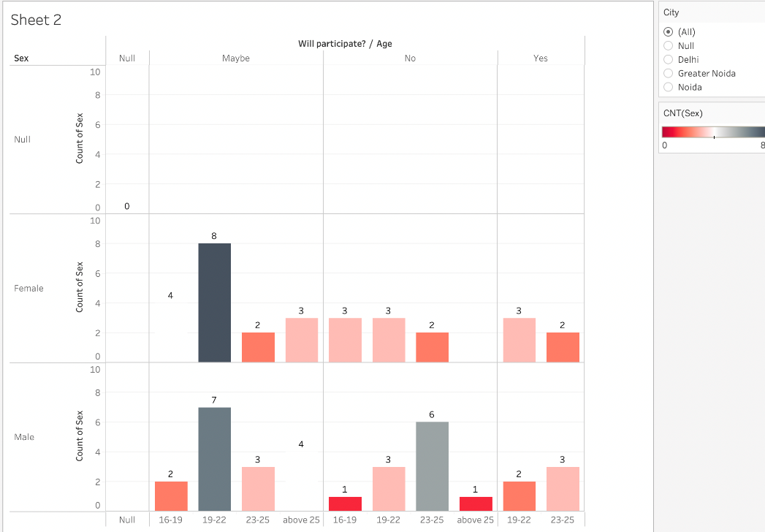
Graph 6: Participation of respondents in such online talent shows if ever get the chance by the demographic variables like age and sex.
Interpretation: This graph shows the participation of the respondents based on their sex and age-group if there is paid entry for the participation.
First if we focus on the females only then it is observed that 8 females and 7 males are not sure either they will participate or not and both belong to the same age-group. This shows that both the genders of this age group aren’t sure about their participation. 6 males denied their participation which is highest number of denial and the age group is 23-25.
We can observe that total of 10 are agree to participate in such kind of talent shows and the number of the male and female who are willing to participate in future is same i.e., 5.

Slide 24
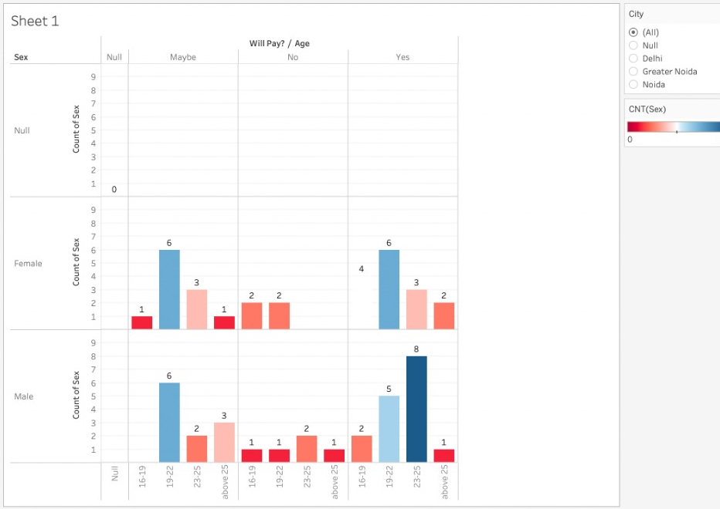
Graph 7: Participation of individuals in such shows if it's for social cause.
Interpretation: This mentioned graph shows that if an online talent show is organized and the fund collected will be used as donation for the social cause.
This graph interprets that total of 12 are not sure for the participation even if it is for the social cause fundraiser program. The number of females and males are equal i.e. 6. The both genders here are of the same age group of 19-22.
There are also who denied their participation and their total is 9 which includes 4 females and 5 males.
By the graph we can easily analyze that total of 11 including 6 females and 5 males agreed to participate of age-group 19-22. Males of 23-25 age-group hugely agreed as compared to female of same age-group with number of 8 and 3 respectively.

Slide 25
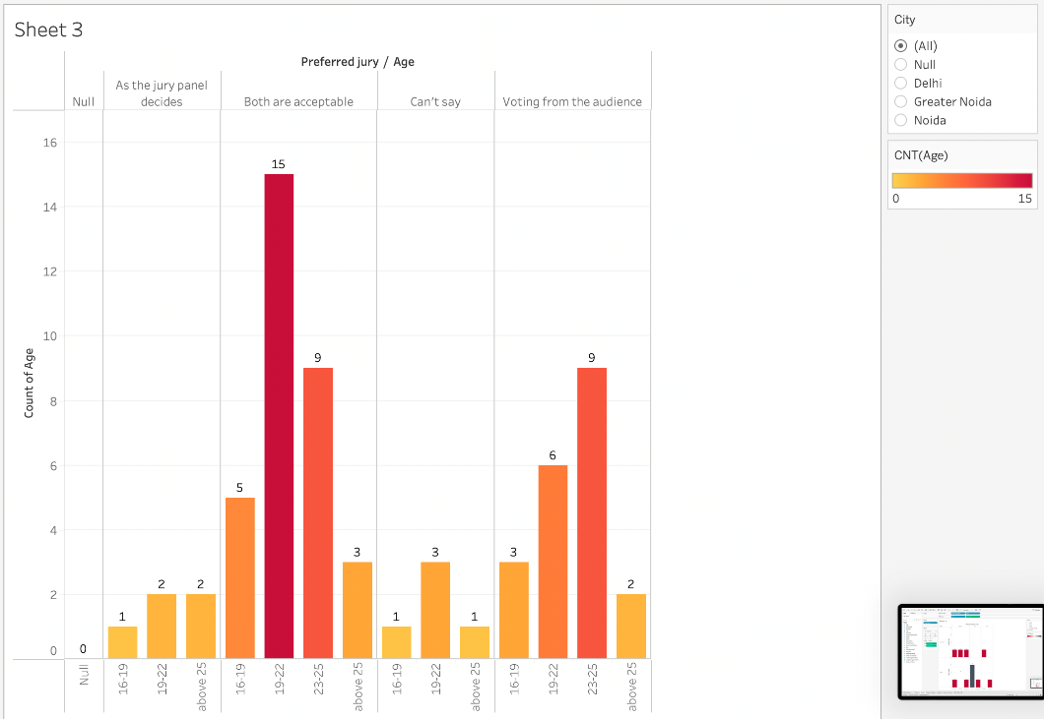
Graph 8: Participants preference for jury for the online talent shows.
Interpretation: This graph shows what the respondents of the survey think about the jury or the judging of the show so that the judging of the performances will go fairly and smoothly.
Only a total of 5 people think that the jury panel decided by the host is good for the judging the act or performances.
Similarly, a total 5 people aren’t sure about how the judging should be done.
*nextSlide

Slide 26
There is huge acceptance of ' voting from audience ' from different age group with the total of 20 which is single side preference of the voting from audience than the jury panel. Age-group of 19-22 and 23-25 makes a total of 15 who think voting from audience is far better than the jury panel.
Now, if we see the results when both the ways are acceptable , then 19-22 age-group respondents are 15 who are accepting the both ways and 23-25 age-group respondents with total of 9 are accepting both ways judgement.

Slide 27
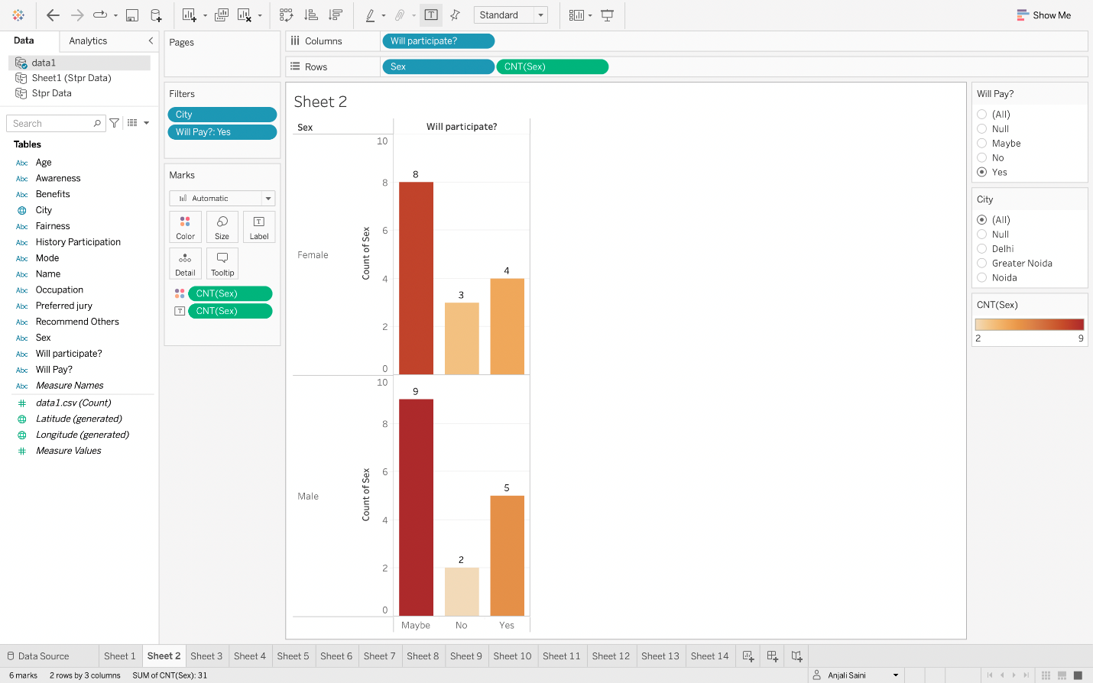
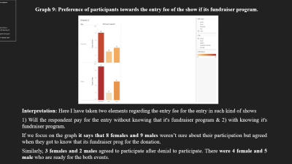
Graph 9: Preference of participants towards the entry fee of the show if its fundraiser program.
Interpretation: Here I have taken two elements regarding the entry fee for the entry in such kind of shows
1) Will the respondent pay for the entry without knowing that it's fundraiser program & 2) with knowing it's fundraiser program.
If we focus on the graph it says that 8 females and 9 males weren’t sure about their participation but agreed when they got to know that its fundraiser prog for the donation.
Similarly, 3 females and 2 males agreed to participate after denial to participate. There were 4 female and 5 male who are ready for the both events.

Slide 28
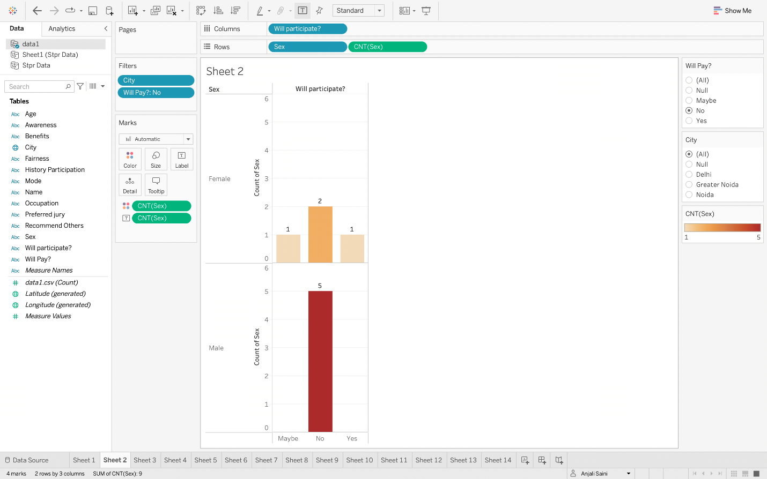
Graph 10. Preference of participants towards the entry fee of the show if its fundraiser program.
Interpretation: Here I have taken two elements regarding the entry fee for the entry in such kind of shows 1) Will the respondent pay for the entry without knowing that it's fundraiser program & 2) with knowing it's fundraiser program.
If we focus on the graph, it says that 2 females and 5 males weren’t ready to participate in any case either its for donation or not. There was 1 female who was unsure about the participation and when she heard that its for donation she still denied for the participation.
Also, there was 1 female who said yes for the participation first with paid entry but denied when she got to know that it’s a fundraiser program.

Slide 29
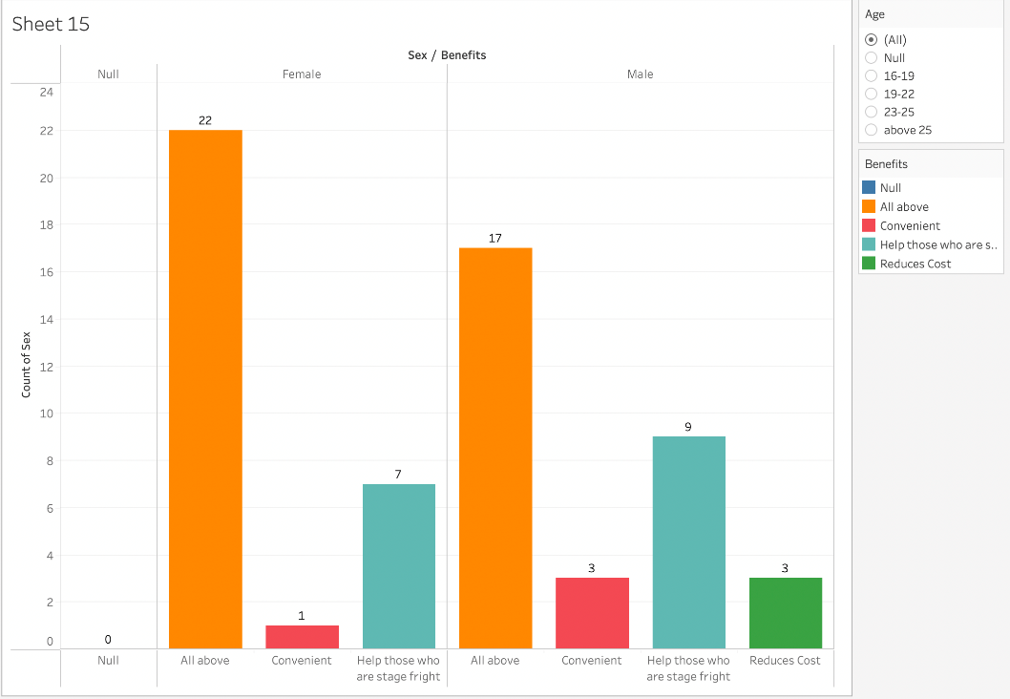
Graph 11. Benefits of the online talent shows classified by the gender of the respondent.
Interpretation: This graph says that 22 females and 17 males say there are all mentioned benefits will be nurtured by the online talent shows, which include 'conveniency', 'help those who are stage fright' and 'reduces cost'.
Also 7 females and 9 males said that it will help only to 'overcome stage fright.'
None of the female was agree that it will reduce cost but 3 males were agreeing with this benefit of the online paid talent show.

Slide 30
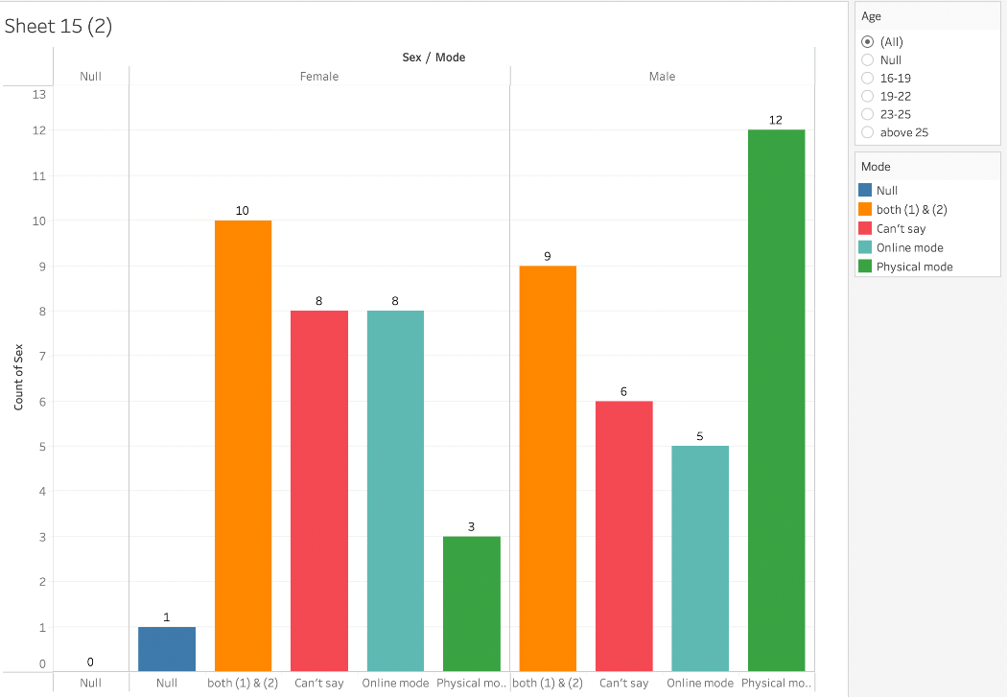
Graph 12. Preferences of respondents over mode of conduction based on gender of the individual.
Interpretation: According to this graph its visible that 12 males are preferring physical mode, 5 for online mode, 6 were not able to show their preference and 9 were ready for both the options.
According to this graph its visible that 3 females are preferring physical mode, 8 for online mode, 8 were not able to show their preference and 10 were ready for both the options.
Which shows that female are more oriented towards the online mode as compared to the physical mode.

Slide 31
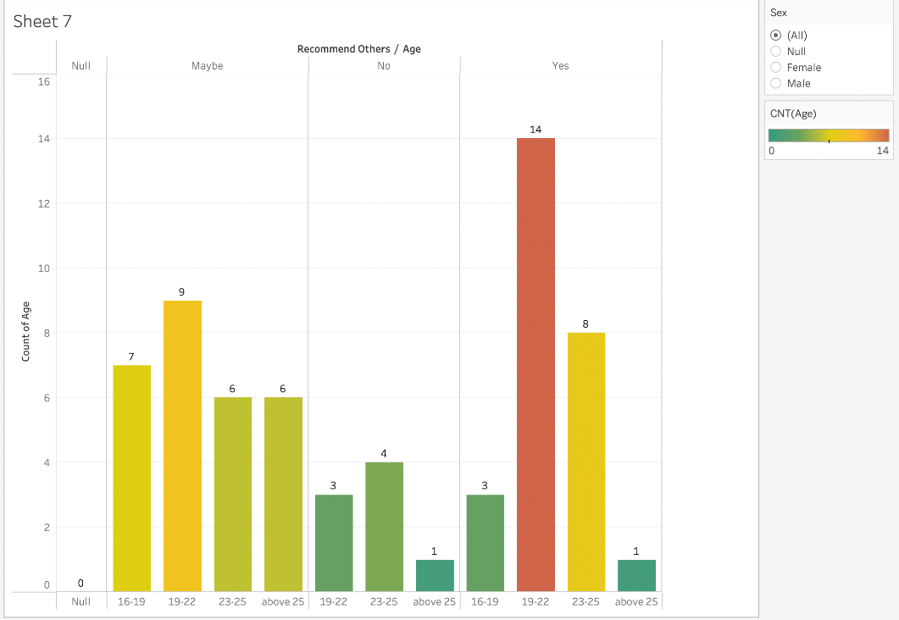
Graph 13. Recommend other for the participation or participate themselves.
Interpretation: This graph state the liking towards the show as this graph says about the recommendation to others by respondents and participation of respondents themselves.
28 were not sure that they will participate or recommend others.
11 denied their participation as well denied that they will recommend other for the participation.
27 said they will participate/recommend others for such online paid talent shows in which 14 were from the age group of 19-22 and 8 from age-group of 23-25.

Slide 32
7. Findings and Conclusion
7 Females weren’t aware of the online talent shows & 8 male were also unaware of such thing. There are 23 female and 24 male respondents were aware of such online shows.
The number of respondents who are not aware are 15 and who are aware are 47 based on the occupation.
People having job who are aware about these kinds of shows are 10 and who are not aware are only 3. Self-employed are also aware with the number of 4.
Only 9 college students and 3 respondents having job have history of participation in such kind of online talent shows.
8 females and 7 males are not sure either they will participate or not and both belong to the same age-group.
6 males denied their participation which is highest number of denial and the age group is 23-25.
total of 10 are agree to participate in such kind of talent shows and the number of the male and female who are willing to participate in future is same i.e., 5

Slide 33
total of 11 including 6 females and 5 males agreed to participate of age-group 19-22. Males of 23-25 age-group hugely agreed as compared to female of same age-group with number of 8 and 3 respectively.
19-22 age-group respondents are 15 who are accepting the both ways and 23-25 age-group respondents with total of 9 are accepting both ways of judgement.
Age-group of 19-22 and 23-25 makes a total of 15 who think voting from audience is far better than the jury panel.
it says that 8 females and 9 males weren’t sure about their participation but agreed when they got to know that its fundraiser prog for the donation.
3 females and 2 males agreed to participate after denial to participate. There were 4 female and 5 male who are ready for the both events.
2 females and 5 males weren’t ready to participate in any case either it's for donation or not.
1 female who said yes for the participation first with paid entry but denied when she got to know that it’s a fundraiser program.

Slide 34
22 females and 17 males said that all mentioned benefits will be nurtured by the online talent shows.
that 12 males are preferring physical mode, 5 for online mode, 6 were not able to show their preference and 9 were ready for both the options.
3 females are preferring physical mode, 8 for online mode, 8 were not able to show their preference and 10 were ready for both the options.
28 were not sure that they will participate or recommend others.
11 denied their participation as well denied that they will recommend other for the participation.
27 said they will participate/recommend

Slide 35
8. Suggestions
To make such events successful we have to make people more aware about these things
As there are large number of people aren’t aware of these things.
We have to make college students more aware about it beside the fact they are the most aware segment according to the occupation.
Males prefer physical mode more than online so we have to make the understand the importance of online conduction of these kinds of shows.
According to the analysis the jury panel was denied as compared to audience voting so we have to take very important steps towards the kind of jury.
Entry fee is a very concerning fact as participants don’t want to give money for giving performances. So, earn revenue they should tend to the sponsorship.

Slide 36
Participants are willing to pay for the entry if it’s a fundraising program so if the host is taking money for the entry it should use for the donation.
But due to conditions arises in which participant is not willing to participate due to travelling or any other issue the it may become a good option.
Participants should be made aware about the benefits of the such online shows as they aren’t sure about it how it will help them in enhancing their personality as they think it will make people more introvert or stage fright.
We have to take necessary steps towards the platform for the conduction of such shows as participants are concerned about the fair and smooth conduction of the show.

Slide 37
9. Limitations
Despite of all possible efforts to make the market research mare comprehensive and scientific, study has certain following Limitations.
The study is confined to Delhi NCR only. Any suggestions given by analyzing data Collected may not be accurate for other locations as people requirements and expectations differ from one place to other.
There existed some respondents who refused to respond and these respondents who did not participate in the survey may not be distinct & might have affected the result of the study.
The sample size was chosen randomly which might not be appropriate which led to few errors in the study.
Many of respondents did not furnish true information, they provided Information just to complete the questionnaire, this affected the study.
Some of the respondents did not furnish all the information required for the study.

Slide 38
References
https://learn-grow-blossom.com/virtual-talent-show/
https://www.cvent.com/en/blog/events/virtual-events
https://www.alliedmarketresearch.com/virtual-events-industry-market-A06596
https://www.grandviewresearch.com/industry-analysis/virtual-events-market
https://www.mynewsdesk.com/brandessence/pressreleases/virtual-events-market-in-depth-research-report-2021-3108067
https://www.businesswire.com/news/home/20210907005584/en/Global-Virtual-Events-Markets-Report-2021-COVID-19-Impacts-and-Forecast-to-2027---ResearchAndMarkets.com
https://www.researchandmarkets.com/reports/5411734/global-virtual-events-market-by-event-type?utm_source=BW&utm_medium=PressRelease&utm_code=k52dcp&utm_campaign=1586516+-+Global+Virtual+Events+Markets+Report+2021%3a+COVID-19+Impacts+and+Forecast+to+2027&utm_exec=chdo54prd
https://www.brella.io/blog/how-virtual-events-are-changing-the-event-industryhttps
://info.workcast.com/blog/virtual-events-vs-in-person-events
https://www.investopedia.com/terms/m/marketing.asp
https://roxeventstaff.com/what-virtual-event-and-in-person-attendees-want/
https://keydifferences.com/difference-between-sales-and-marketing.html
https://keap.com/product/sales-funnel
https://public.tableau.com/en-us/s/about

Slide 39
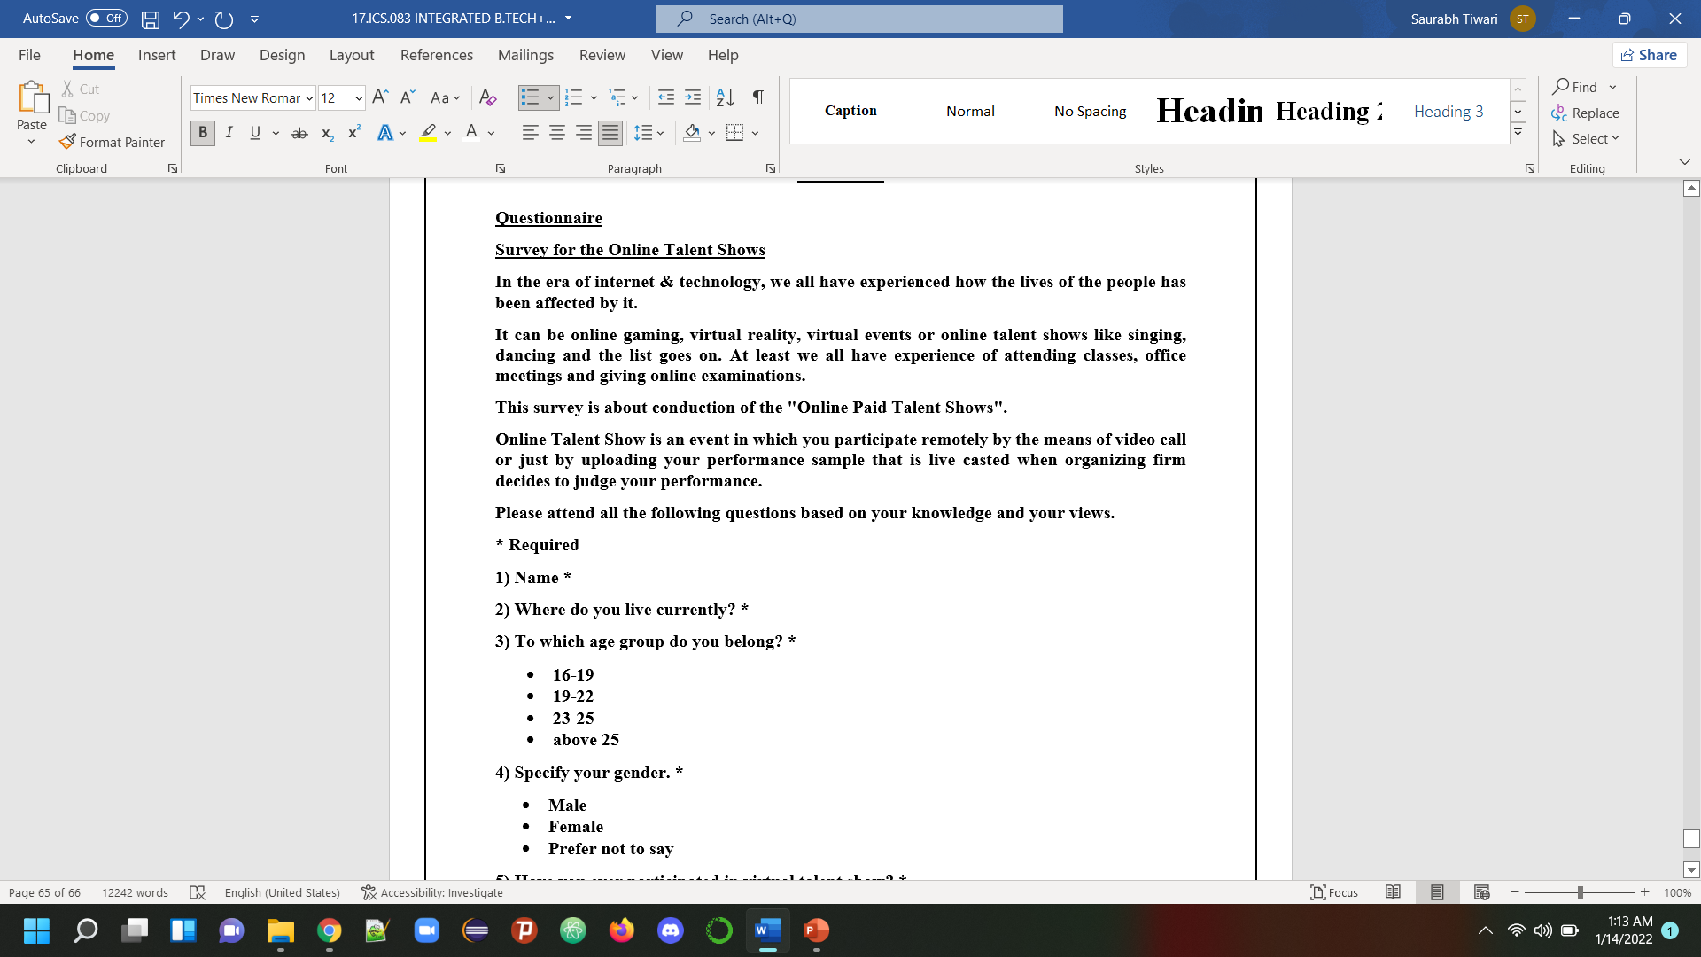
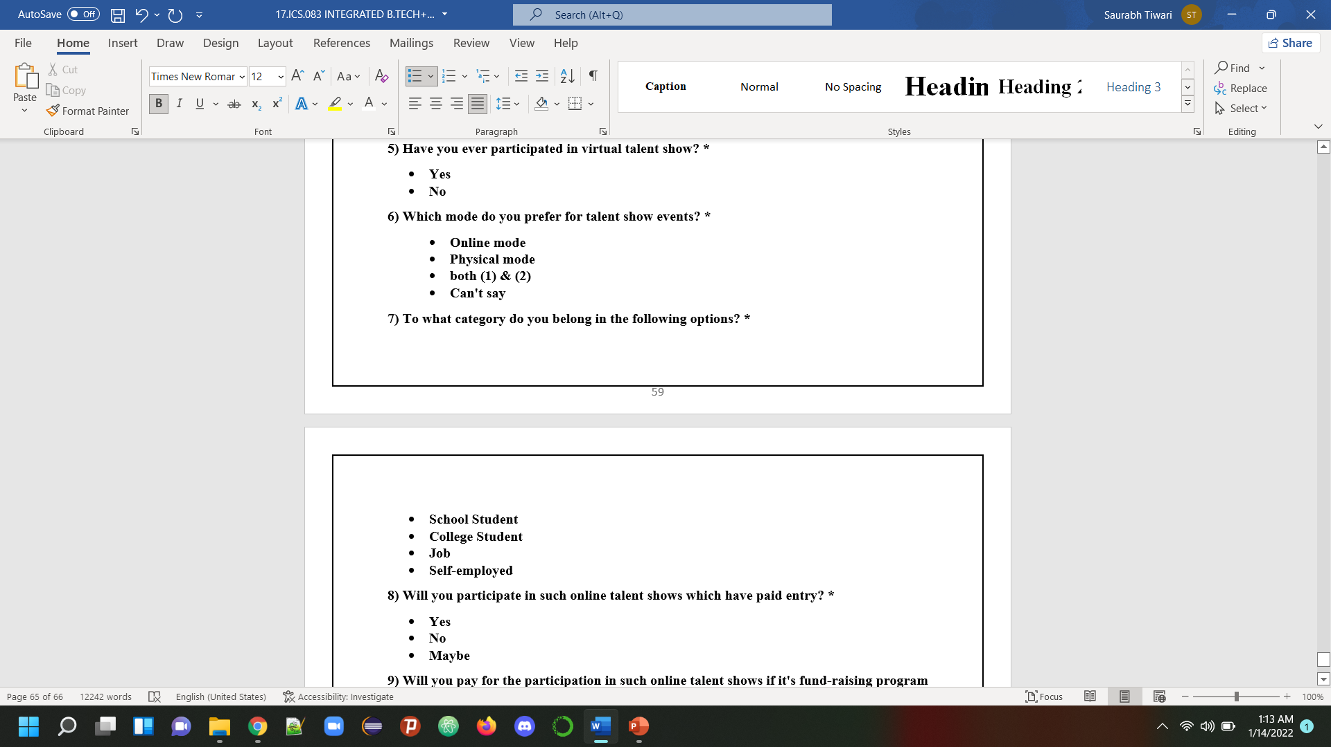
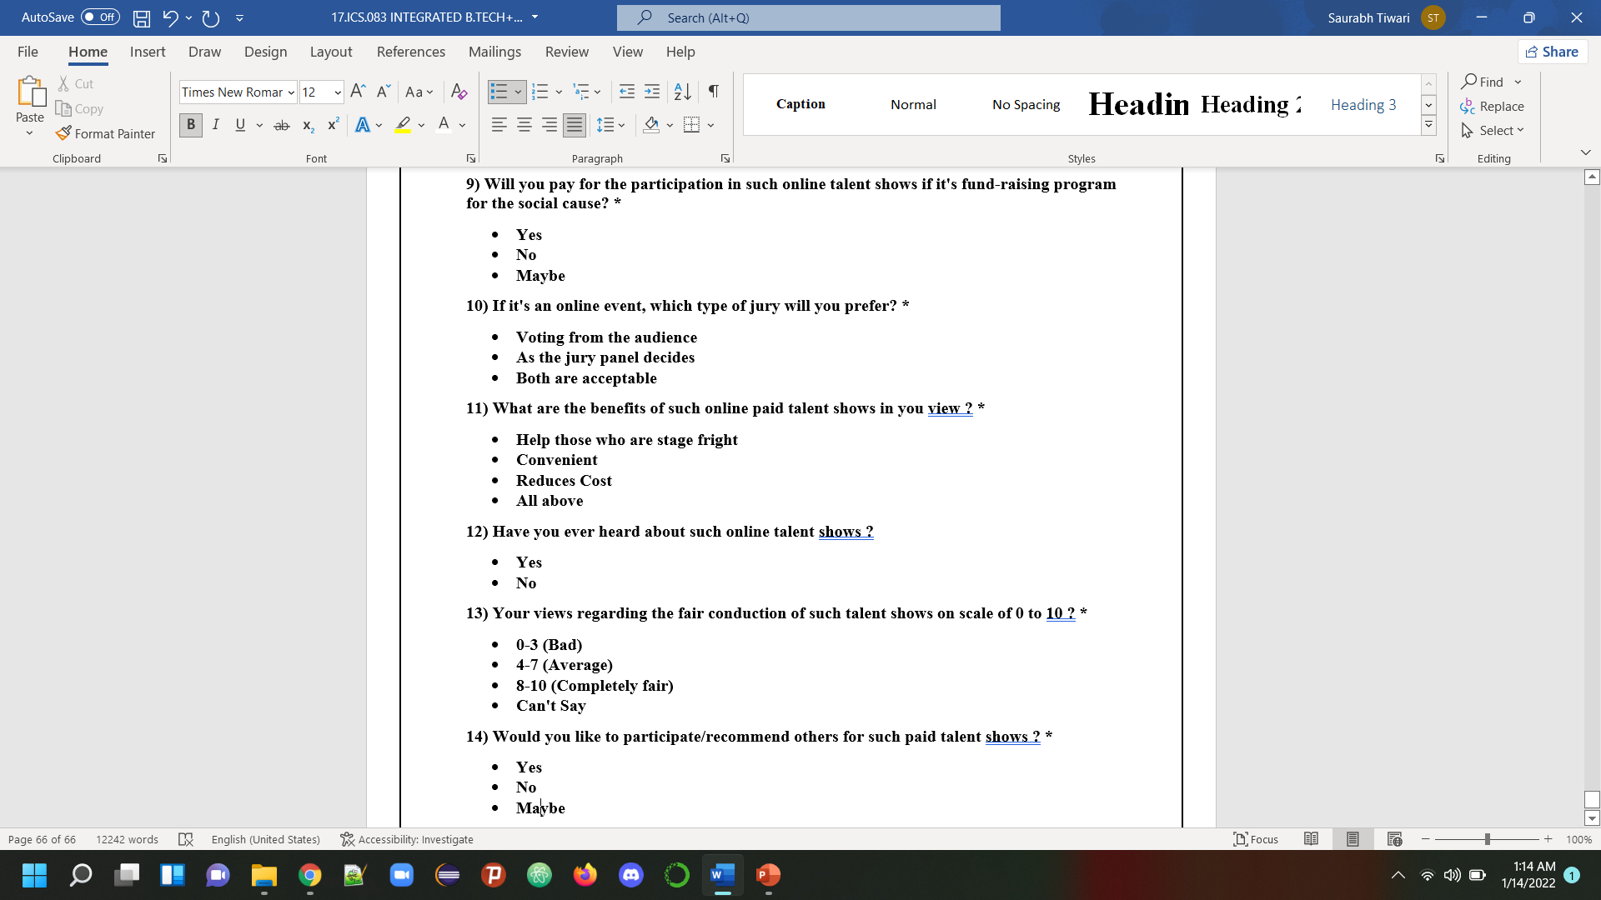
Annexure

